Slide 1
Programme Overview
Learning Objectives
At the wend of this 7 part programme, student will:
Consider their own financial personality, and their relationship with money
Understand how income can be earned or unearned and the impact and purpose of taxation
Identify some savings and spending measures to help them plan
Understand credit and debt, including options, costs and impact
Identify ways to counter inflation through investing and identify investment risk
Examine insurance options including compulsory, voluntary, costs, claiming and other factors
How budgeting provides structure to goals and planning

Slide 2
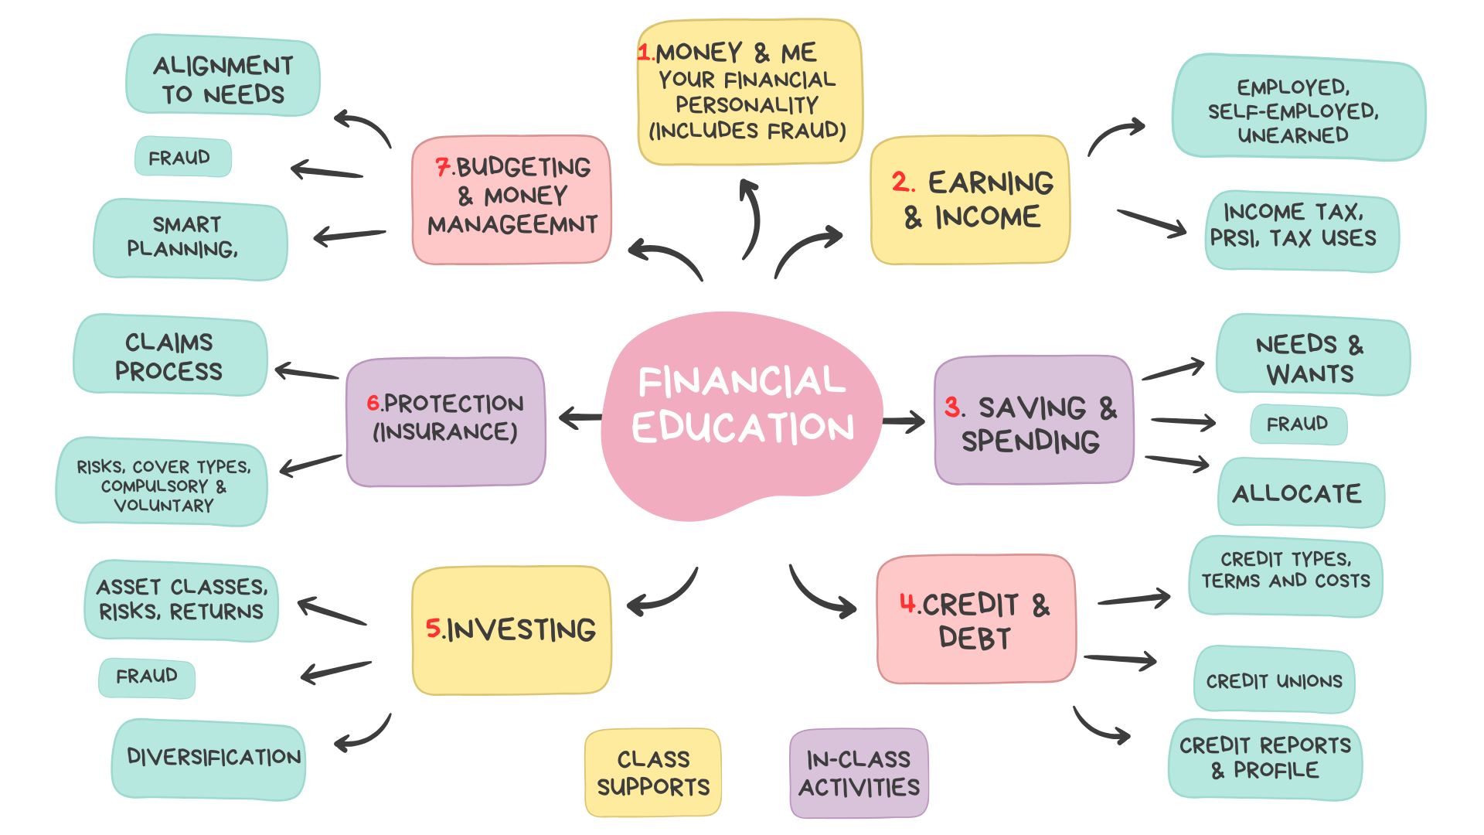
What is covered in the 7-part programme
Student & Teacher Supports build into each lesson

Slide 3

What is covered in the 7-part programme

Slide 4
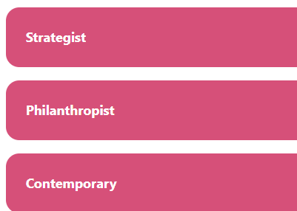
1. Money & Me
What is your money personality?
Conducted in a GROUP setting
How the scoring works:
Strategist = 1 point
Philanthropist = 2 points
Contemporary = 3 points
There are 9 questions
100% Strategist = 9 points
100% Philanthropist = 18 points
100% Contemporary = 27 points.
Personality types will be either absolute or ‘leaning towards’
Link to online test / scoring]
Or access the game HERE

Slide 5
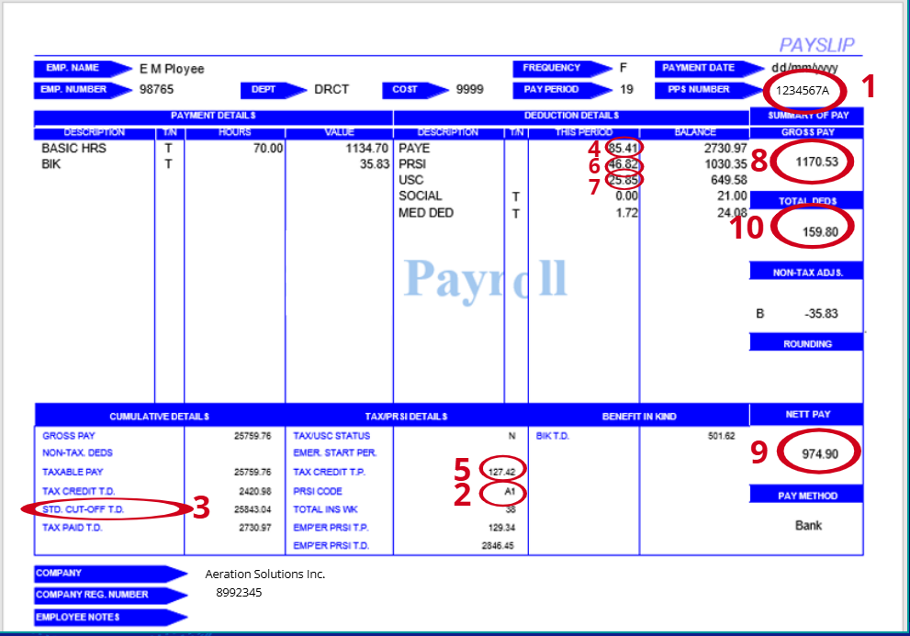
2. Earning & Income
Reading a payslip example, where taxes go…

Slide 6
3. Saving & Spending
A simple rule to allocating your money between needs, wants and savings.
Needs
Wants

Slide 7

4. Credit & Debt
Is there ‘good’ debt and ‘bad’ debt?
Place a tick mark where you agree
Purpose | Good Debt | Bad Debt | Reason
Home Loan (Mortgage)
New Car
Credit Card
Holiday
Buy-Now-Pay-Later (Online Shopping for Wants)
Education

Slide 8
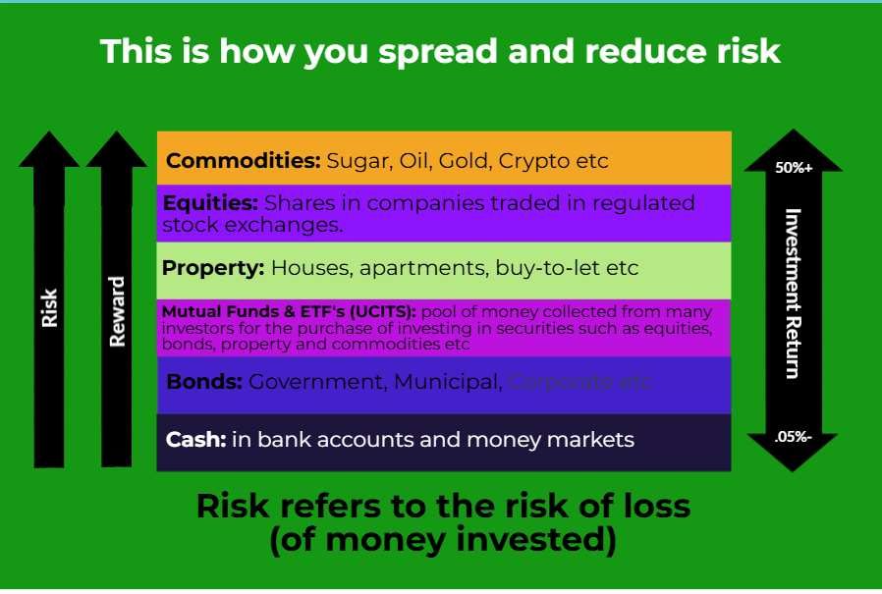
5. Investing
Introducing key concepts

Slide 9

6. Insurance
Types, claims and more!

Slide 10
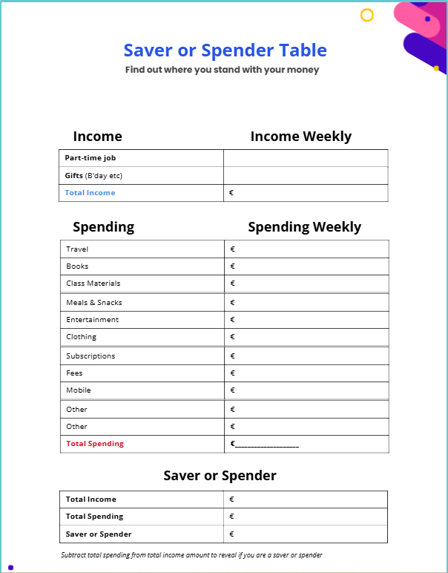
7. Budgeting & Money Management
Putting realistic plans in place

Slide 11
Teacher / Class Supports
In-class Activities
Designed to support consideration of key financial concepts and in class discussion and collaboration

Slide 12

Thank You

