Slide 1

Money & Me
Relationship with Money
Learning Objectives
At the wend of this module, student will:
Have an understanding of how they view money
Identify personal behaviours that can impact their financial wellbeing
Put supports in place to help them build financial resilience and plan for the future
Consider how fraud may have an impact on their financial plans.
Linking with Junior Cycle Business Studies [CSPE (Volunteerism, Community Activity)] Modern Business Studies.

Slide 2

What Does This Lesson Discuss?

Slide 3
Teacher Supports
My Relationship with Money
(Money & Me)
The Teacher Supports carry the same slides as those for the students but with the additional slides that provide answers in the class discussion sections. In this slide deck, Slides (6, 8, 9, 10, 15, 19, 20, 33, 37] are unique to the teacher. These would be combined with similar Teacher Supports in Lessons 2 – 7 to form the Teacher Workbook.

Slide 4

Class Discussion 1 Do you know what the following terms mean?
Minimum Wage
Earned Interest
PAYE Earner
“My finances are in the RED”
Financial Fraud
Have you ever been in the company of someone that has used those terms? List examples ______________
Are there other financial terms you may have come across that you would like to learn more about _______

Slide 5
Class Discussion 2 Can you answer the following
Minimum Wage – within 10 cents, what is the minimum wage hourly rate in Ireland presently?
Earned Interest – provide a common example of how this would apply to you?
PAYE Earner – provide 3 examples of workers that are categorized as PAYE earners?
“My finances are in the RED” – list 3 example of why someone might say this?
Financial Fraud – can you name some common types of financial fraud?

Slide 6
Class Discussion – can you answer the following Teacher Answers
Minimum Wage – €14.15 per hour for employees aged 20 and over. Reduced rates apply for employees under 20: 19-year-olds (€12.74), 18-year-olds (€11.32), and those under 18 (€9.91)
Earned Interest – In Ireland, earned interest refers to the profit generated from depositing money into a financial institution, purchasing government bonds, or other interest-bearing instruments.
PAYE Earner – A Full-Time Office Administrator: A person employed in an office on a permanent contract with a set salary, overtime, and benefits like health insurance, where the employer deducts all taxes before paying them. A Retail Assistant or Barista: A part-time worker in a shop or cafe who receives a weekly or monthly salary, which is subject to standard PAYE deductions. A nurse employed in a hospital.
“My finances are in the RED” – list some example of why someone might say this? Unexpected Major Expenses (Lack of Emergency Fund): A sudden, unplanned event such as a medical emergency, urgent car repair, or emergency home repair can drain savings instantly. Without an emergency fund to cover these costs, an individual is forced to use high-interest credit cards or loans to pay for them, immediately pushing their finances into a negative state. Job Loss or Significant Reduction in Income: A sudden loss of income, such as being laid off, can lead to a situation where a person cannot cover their basic monthly expenses (rent, utilities, food). Without income, existing debts and living costs quickly exceed available funds, causing a rapid shift from black to red. Overspending on Credit (Living Beyond Means): Consistently spending more than one earns, often aided by easy access to credit cards, leads to a debt trap. When credit card debt builds up, the accumulated interest payments become so high that the minimum payments exceed the person's ability to pay, causing the total debt to snowball and the person to fall into the red.
Financial Fraud - Financial fraud involves deceptive practices to illegally obtain money, assets, or data from individuals or organizations, often through phishing, investment scams, or identity theft. These crimes, which frequently leverage urgency and trust to exploit victims, cause significant financial losses and erode trust in financial systems.

Slide 7
Class Discussion 2 (a, b, c)
A. Minimum Wage – why do you think there is a minimum wage passed as law in Ireland? Discuss
B. PAYE Earner – this refers to the income tax employees pay directly from their wages. What are some of the uses that PAYE is used by Government? Discuss.
C. What are the risks of financial fraud to someone that is saving for a goal in the future? Discuss.

Slide 8
Class Discussion 2 (a) –
Teacher Answers
(Minimum Wage)
Key reasons for Ireland's minimum wage include:
Protection Against Exploitation: It prevents a "race-to-the-bottom" in wage competition, ensuring all employees, including part-time and casual workers, receive a legal minimum compensation.
Reducing Income Inequality: The policy helps lower income disparity within society.
Economic Benefits: A higher minimum wage can increase productivity, improve employee retention, and boost consumer spending in the economy.
Assessing Living Costs: The rate is monitored by the Low Pay Commission to ensure it remains fair, sustainable, and reflective of the cost of living without causing significant job losses.
Social & Economic Stability: It serves as a necessary, fair wage floor, especially during economic fluctuations.

Slide 9
Class Discussion 2 (b) –
Teacher Answers (PAYE & Income Taxes)
The primary uses of PAYE tax revenue include:
1. Public Services and Infrastructure
PAYE funds the daily operation of state services, including:
Healthcare: Funding the Health Service Executive (HSE), hospitals, and medical card schemes.
Education: Funding schools, universities, and teacher salaries.
Infrastructure: Investment in public transport, road networks, and public building maintenance.
2. Social Protection and Welfare
A significant portion of the deductions, specifically PRSI, goes directly to the Social Insurance Fund. This fund supports:
State Pensions: Payments for retired individuals.
Social Welfare Benefits: Jobseeker's benefit, illness benefit, and maternity/paternity leave payments.
3. State Services and Administration
Public Sector Salaries: Funding the wages of teachers, nurses, gardaí (police), and civil servants.
Universal Social Charge (USC): This tax specifically funds general state services.
4. Specific Schemes and Incentives
Through the PAYE system, certain deductions or exemptions are used to support specific government initiatives:
Cycle to Work Scheme: Allows employees to purchase bicycles tax-efficiently.
Tax Reliefs: Funding for deductions like the Employee Tax Credit, flat-rate expenses, and remote working relief.
Pension Tax Relief: Allowing tax relief on pension contributions.
Key Points on Distribution
Social Protection & Health: In Ireland, social protection, healthcare, and education form the largest categories of expenditure for tax revenue.
Direct to Revenue: Employers deduct these taxes in real-time, ensuring a steady stream of funding for public services throughout the year rather than a single lump sum

Slide 10
Class Discussion 2 (c) –
Teacher Answers (Financial Fraud)
The primary uses of PAYE tax revenue include:
Common Types of Financial Fraud
Phishing and Vishing (Digital Scams): Criminals use fake emails (phishing), texts (smishing), or phone calls (vishing) to impersonate banks or trusted entities, stealing personal/banking details.
Investment and Crypto Fraud: Promises of high returns with little risk are used to steal money, with a recent surge in cryptocurrency-related scams.
Identity Theft/Account Takeover: Stealing personal information to open accounts, take over existing bank accounts, or commit crimes in the victim's name.
Advance Fee Fraud: Victims are tricked into paying upfront fees for promised, but non-existent, prizes, loans, or lottery winnings.
Rogue Traders (Doorstep Crime): Uninvited individuals offering unnecessary home repairs (e.g., roofing, paving) who overcharge, perform poor work, or take money without finishing the job.
Corporate/Internal Fraud: Manipulation of financial records, insider trading, or misappropriation of assets within a company.
Warning Signs of Fraud
Unsolicited Offers: High-return investment offers from unknown sources.
High-Pressure Tactics: Urgency to "act fast" to avoid missing a "once-in-a-lifetime" opportunity.
Unconventional Payment Methods: Requests for payment via wire transfers, gift cards, or cryptocurrency.
Request for Personal Data: Unsolicited calls or messages asking for passwords, PINs, or bank details.
Prevention and Protection
Verify Identity: Never share security information; hang up and call the official, verified number of the organization.
Monitor Accounts: Regularly check bank statements and credit reports for suspicious activity.
Use Strong Security: Employ two-factor authentication (2FA) and unique, strong passwords for all financial accounts.
Research First: Investigate companies and individuals before committing fund

Slide 11
Money Matchup – millionaires, billionaires and trillionaires
The objective of this exercise is to consider people and money. In particular, we have nine public figures that have, in their own way, differing relationships with money. Some want more, some want to share it and others have given their lives to helping others.
The exercise should be conducted to examine which, if any of the people listed would have more, or less impact on your own attitude to money.

Slide 12
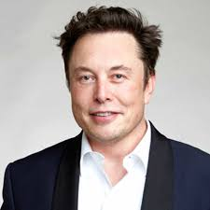
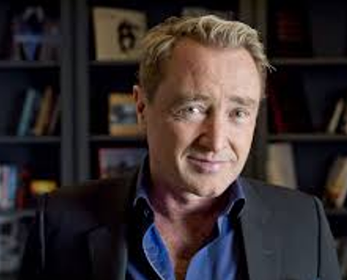
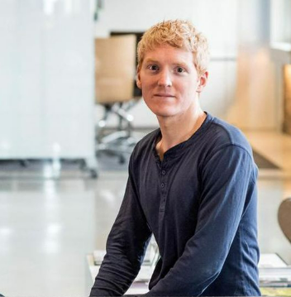
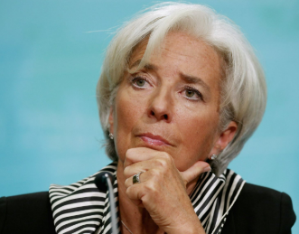
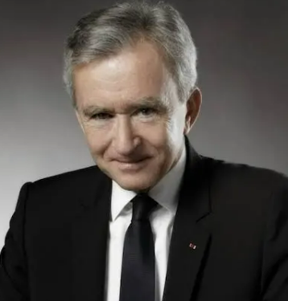
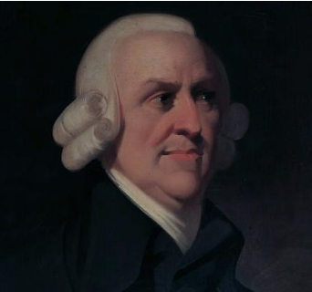
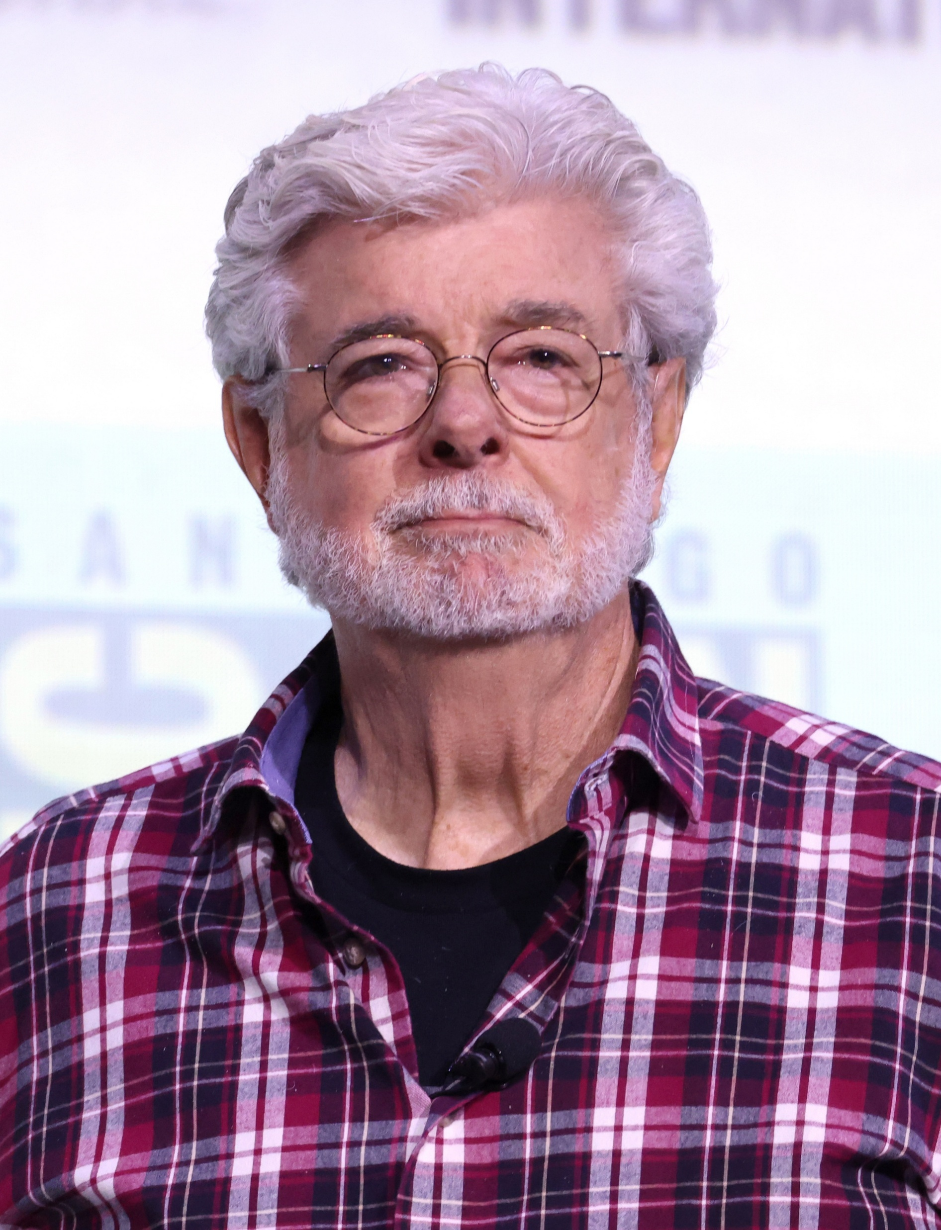
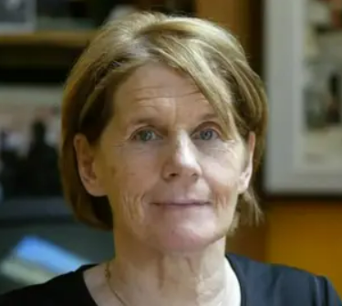
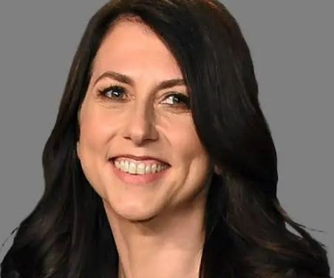
Money Matchup – millionaires, billionaires and trillionaires
Beginning on the top left…
He is wealthier than some entire nations with his US$1 Trillion pay”
It was recently claimed that this person had a …“lifestyle of a Monte Carlo millionaire”
I am concerned about ‘red tape’ in Ireland because I believe excessive bureaucracy and, specifically,, complex planning laws are hindering the development of vital infrastructure, including housing and energy projects.
I sign your Euro notes – and seek to control inflation and protect the value of your Euro
I became Europe's richest person by selling luxury goods
I am often called the founder of modern economics
My movie hits have been a big plus for my bank account
I fought for social justice
I donated about US$7 Billion to good causes in 2025

Slide 13
Money Matchup – millionaires, billionaires and trillionaires
Elon Musk – CEO pay packet, after much debate was settled at $1 Trillion – this is equal to 3 years of all income in Ireland
Michael Flatley – In a 2026 Belfast court, the plaintiff’s accused Mr. Flatley of living a “…lifestyle of a Monte Carlo millionaire”
Patrick Collison – At the 2026 Young Scientist Awards, the Limerick-born billionaire and founder of Stripe stated he was “…concerned about ‘red tape’ in Ireland” as it can limit opportunities to social inclusion in Ireland (housing, infrastructure)
Christine Lagarde – As president of the European Central Bank, her signature graces Euro notes issued under her leadership.
Bernard Arnault – He is the head of LVMH (Louis Vuitton Moet Hennesy, the luxury brands firm based in Paris.
Adam Smith – as the author of The Wealth of Nations, he is credited as the founder of modern economics, where true national wealth is not measured by hoarded gold, but by the total production and standard of living of its people, best achieved through free markets, division of labour, and limited government intervention. He argued that self-interested individuals competing in a free market are led by an "invisible hand" to promote the general prosperity of society.
Peter Jackson – the New Zealand filmmaker is best known as the director, writer, and producer of the Lord of the Rings trilogy and the Hobbit trilogy
Sr. Stanislaus Kennedy - she was a tireless campaigner for social justice and founder of Focus Ireland
MacKenzie Scott – Ex-wife of Amazon founder, Jeff Bezos, she actively supports many social causes with generous donations.

Slide 14
Money Matchup – millionaires, billionaires and trillionaires
Class – Group Discussion.
In groups of 3 – 5 students, consider and discuss the following:
Discuss. Of the people listed, are there any that you find interesting? Why________________
Are there any within the list of people that you feel are offer a good example of financial leadership – Why?

Slide 15
Money Matchup – millionaires, billionaires and trillionaires
Teacher Prompts and Supports:
The objective of this class discussion is to encourage students to consider and reflect on their attitude to money? Would they seek to be more like Elon Musk or Sister Stan? Should we seek to accumulate endless wealth or find a way to end poverty? Is MacKenzie a good example of financial leadership?
Use this session with students to break them into groups, to discuss their thoughts and also, seek out their true, honest opinions with no right or wrong answers.

Slide 16
Money Matchup – millionaires, billionaires and trillionaires
About Elon Musk: Elon Musk is a South African-born, tech-focused entrepreneur, CEO of Tesla, and founder of SpaceX. As of early 2026, he is the world's wealthiest person, heavily invested in advancing electric vehicles, space exploration, artificial intelligence, and neurotechnology, with a net worth estimated over $800 billion. Brands include Tesla, The Boring Company, SpaceX, Grok
About Michael Flatley is an Irish-American dancer, choreographer, and producer who revolutionized traditional Irish dance with his worldwide hit shows, including "Riverdance" (1994) and "Lord of the Dance" (1996). Known for his incredible speed—once holding a Guinness World Record of 35 taps per second—he brought Irish dance to a global arena, performing for over 60 million people.
About Patrick Collison is an Irish billionaire entrepreneur and CEO/co-founder of the global payment technology firm Stripe, which he started with his brother, John, in 2010. A former Young Scientist winner, he previously co-founded Auctomatic and has since focused on economic growth, scientific research, and AI, including co-founding the Arc Institute and launching Fast Grants.

Slide 17
Money Matchup – millionaires, billionaires and trillionaires
Christine Lagarde is a French lawyer and politician serving as the President of the European Central Bank (ECB) since November 2019, the first woman to hold this role. Previously, she was the first female Managing Director of the International Monetary Fund (IMF) from 2011 to 2019 and held several ministerial positions in France. She leads the group that is tasked with, among other things, controlling inflation across the Eurozone.
Adam Smith was born in Kirkcaldy, Scotland, he studied at the University of Glasgow and Balliol College, Oxford, later becoming a professor of moral philosophy. He advocated for free trade, limited government intervention in the economy, and the idea that individual self-interest can lead to societal prosperity, known as the "invisible hand". He is widely considered the "father of modern economics". His importance stems from transforming the study of how societies create and distribute wealth into a systematic academic discipline
Bernard Arnault (born 1949) is a French billionaire businessman, serving as the Chairman and CEO of LVMH Moët Hennessy Louis Vuitton, the world's largest luxury goods conglomerate. As of early 2026, he is one of the world's wealthiest individuals, with a fortune largely derived from his control of over 75 high-end brands like Louis Vuitton, Dior, and Moët & Chandon.

Slide 18
Money Matchup – millionaires, billionaires and trillionaires
Peter Jackson is a renowned New Zealand director, producer, and screenwriter best known for helming The Lord of the Rings and The Hobbit trilogies. His work is characterized by groundbreaking visual effects, often created through his company, Wētā FX. Jackson has won three Academy Awards and directed acclaimed projects like King Kong, They Shall Not Grow Old, and The Beatles: Get Back.
Sister Stanislaus Kennedy, widely known as Sr. Stan, was a prominent Irish Religious Sister of Charity, social innovator, and advocate for the marginalized. She founded the national housing charity Focus Ireland in 1985, the Immigrant Council of Ireland in 2001, and "The Sanctuary" in Dublin, a meditation centre. She was a dedicated campaigner against homelessness and poverty for over 50 years.
MacKenzie Scott is an American novelist and transformative philanthropist with a net worth of ~$40 billion as of Dec 2025. As the ex-wife of Jeff Bezos, she received a 4% stake in Amazon in their 2019 divorce. Scott is noted for her "no strings attached" charitable giving, donating over $19 billion to 2,450+ organizations through her Yield Giving website to support underserved communities.

Slide 19
Money Matchup – (CSVP)
Of the people listed, because some are wealthier than others, do you feel they should have more than one vote in electing our leaders? For example, should Patrick Collison have 100 votes in a general election if he is either paying a greater amount of tax to Ireland or donating significant amounts of his wealth to local charities?
Although she is no longer with us, should someone like Sister ‘Stan’ Kennedy, who did such extraordinary volunteerism and community work have a greater say when it comes to General Elections? Why?
Discuss?
Issues to consider (Teacher):
Who would decide on how voting rights might be re-allocated? Public or vested interests?
How might increased voting rights be re-allocated? 10 extra votes, 100 extra votes per ‘exceptional person’?
Should voting be mandatory in Ireland? Why?
What would your thoughts if someone with enhanced voting rights was later discovered to have committed an impropriety?

Slide 20
Money Matchup – (Business Studies)
If someone becomes a huge business success, but part of that success was as a result of public funding, do you feel a percentage of their business should be given to public ownership?
For example, a student is enrolled in a college AI innovation course. They are in receipt of a SUSI grant. 10 years after graduation, they sell their AI concept / business startup for €1Billion. Should the public be entitled to a share of that success?
Points to consider (Teacher):
What would be a fair percentage of ownership be?
Should the right to public ownership be for life, or a certain number of years after college?
Do you think investors may be reluctant to fund startups if there is a public ownership clause?
If the company ultimately fails, should the public be liable for any outstanding debts?

Slide 21
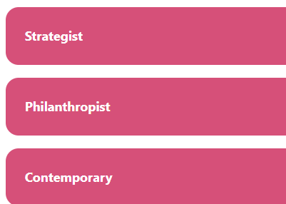
Financial Personality Game Which one are you?
How the scoring works:
Strategist = 1 point
Philanthropist = 2 points
Contemporary = 3 points
There are 9 questions
100% Strategist = 9 points
100% Philanthropist = 18 points
100% Contemporary = 27 points.
Personality types will be either absolute or ‘leaning towards’
Link to online test / scoring]
Or access the game HERE

Slide 22
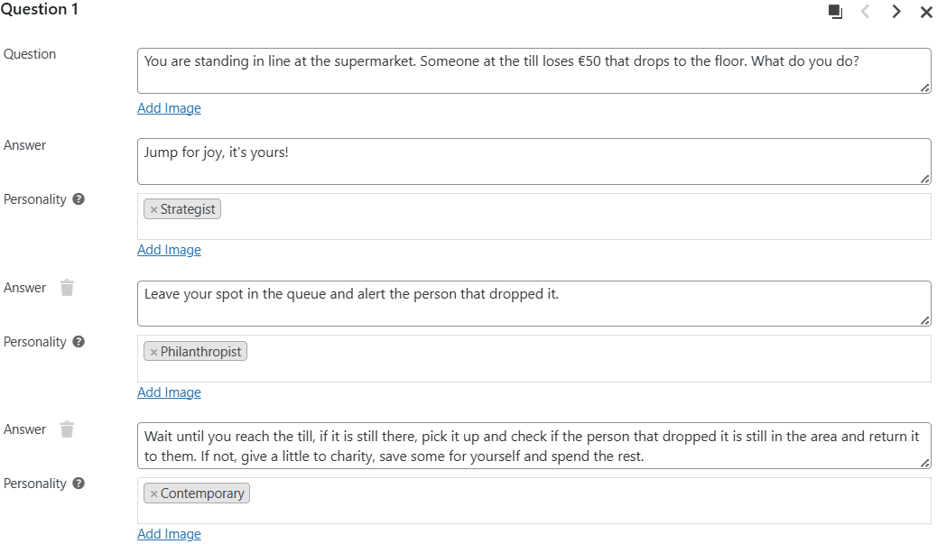

Slide 23
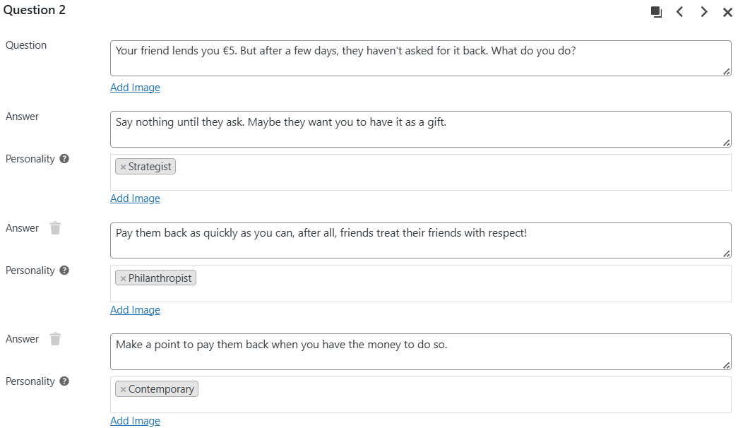

Slide 24
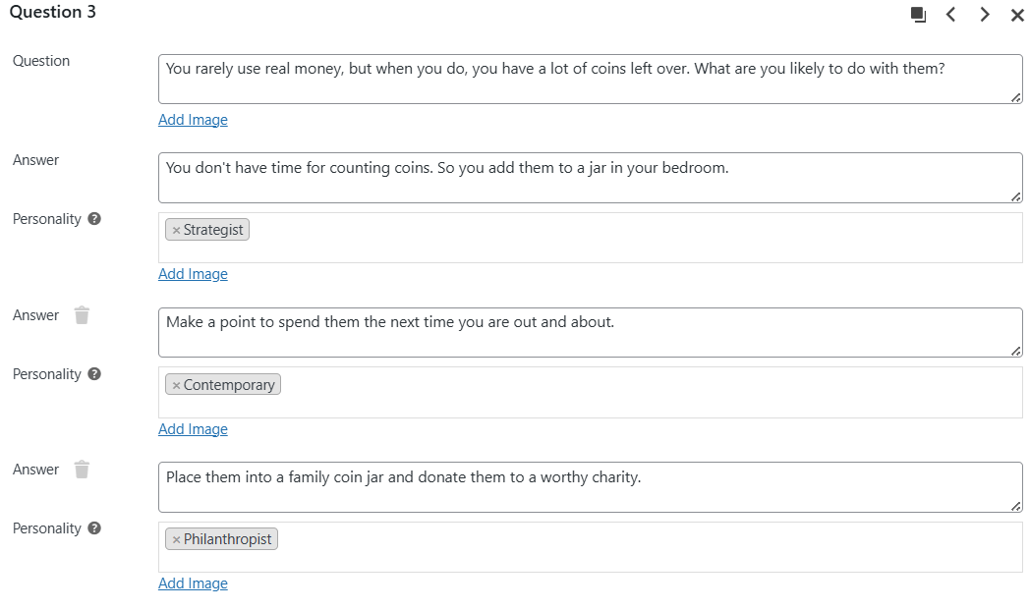

Slide 25
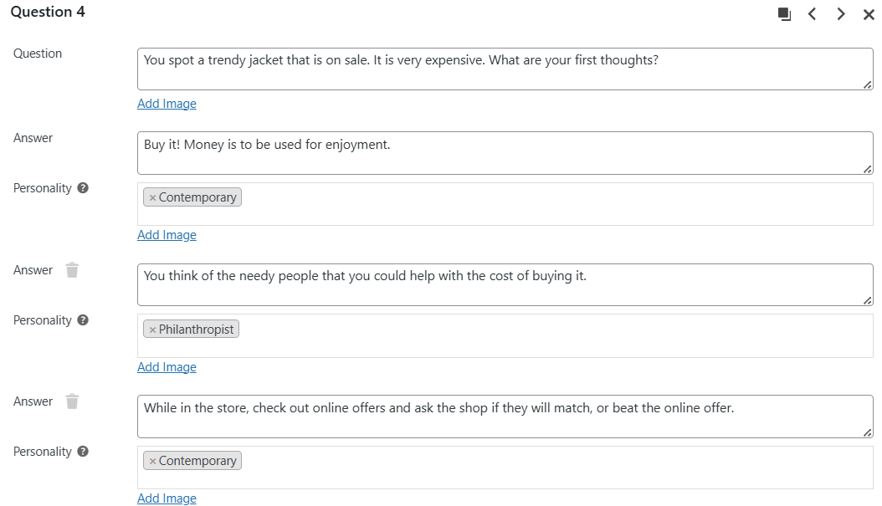

Slide 26
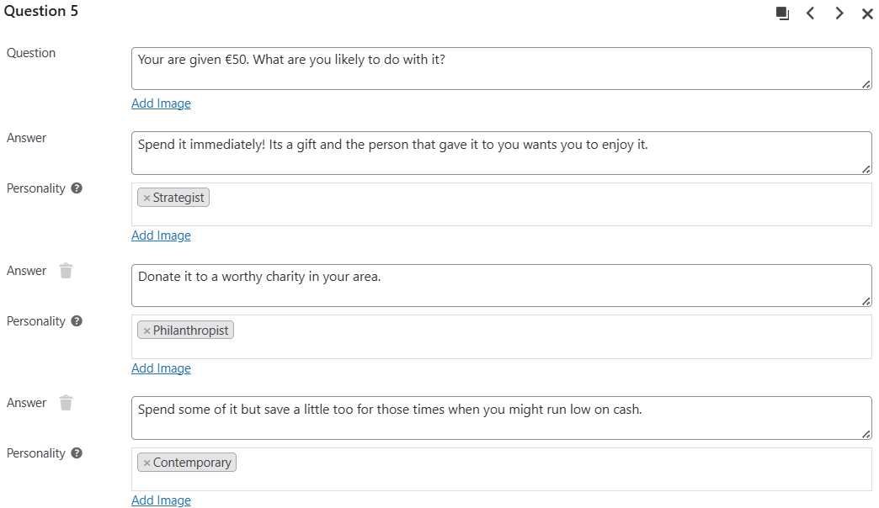

Slide 27
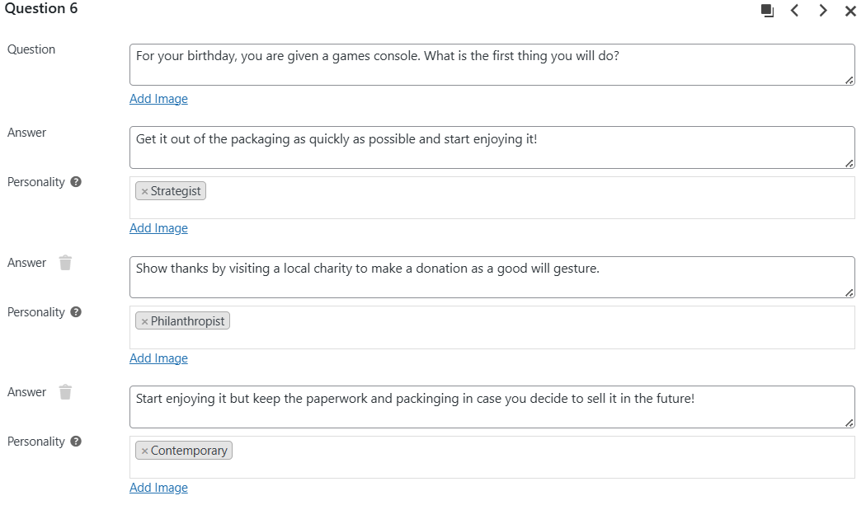

Slide 28
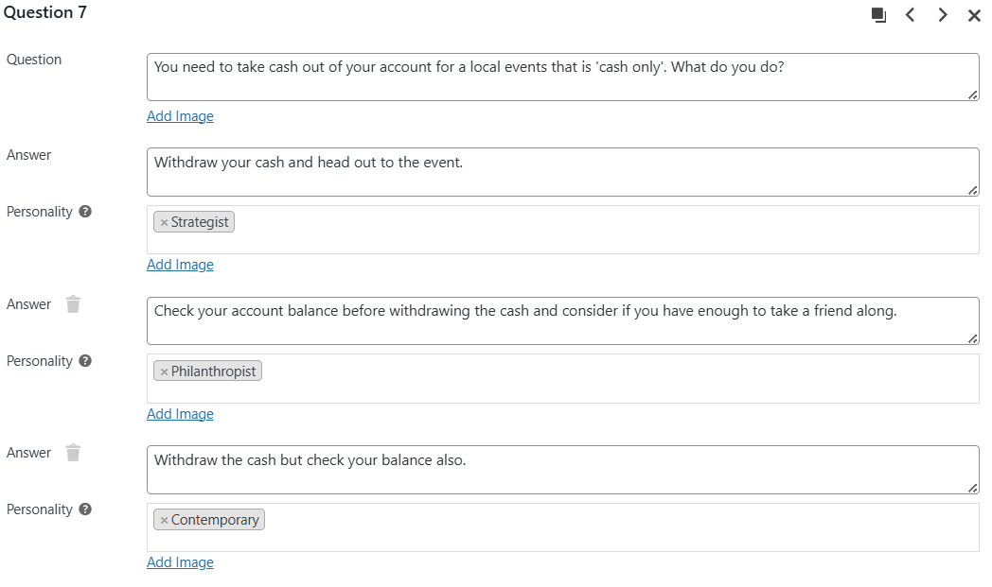

Slide 29
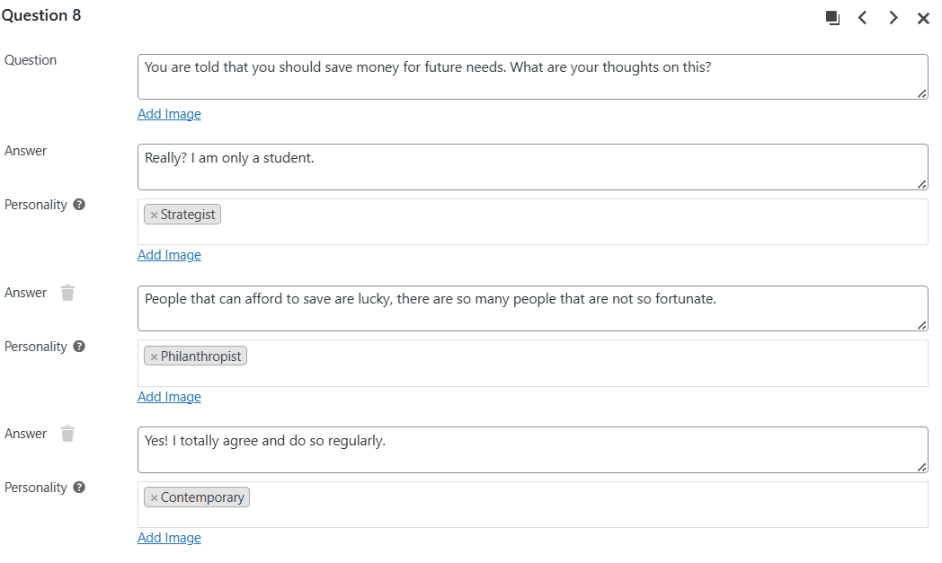

Slide 30
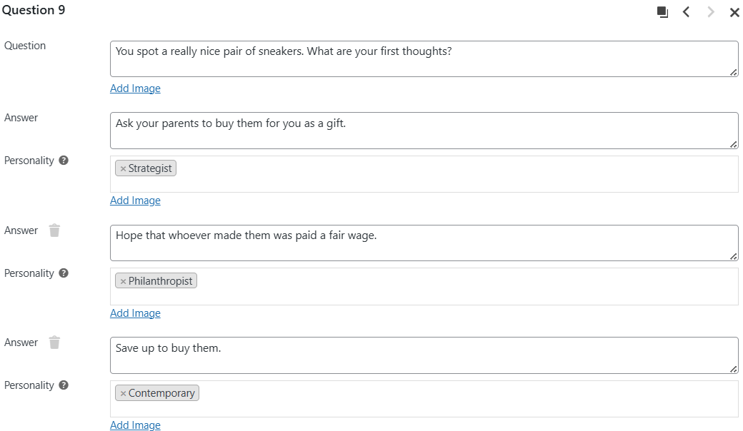

Slide 31
Strategist profile.
This suggests you enjoy money. You view it as something that needs to be used now. Saving is for later, like when you have a real job, with a good income. For now, life is to be enjoyed where possible.
Philanthropist profile.
You prioritise helping others. But your generous nature can sometimes mean you neglect your own financial security.
Contemporary profile.
This suggests you have a healthy respect for money, but you like to enjoy life, while also keeping a little in reserve for the future.

Slide 32
Activity - Money personality reflection time Discuss
Strategist - How would they cope if they have spent all of their money and were suddenly in need of emergency cash to fix a laptop, or take and unplanned trip for a family crisis?
Philanthropist – what if they suddenly were the victim of an online fraud and discovered their money was gone from their bank account? Discuss.
Contemporary– what if they are really good savers, with a lot of savings on deposit but inflation of 10% came back. How might they beat the impact of inflation.
Suggestions:
Strategist– establish a savings habit for the lean financial times.
Philanthropist - seek expert advice.
Contemporary– learn how to invest to beat the impact of inflation.

Slide 33
Activity - Money personality reflection time (Teacher Prompts)
Strategist – They might have to borrow. Or ask for a loan from a family member, or friend. But what might this cost? Interest charges. A favour later perhaps?
Philanthropist – if they were the victim of a fraud, they should first report it to the authorities. The second, depending on the nature of the fraud, if it involved a credit union or bank account, report it there also. Third, they need to use the fraud to learn how to look out for fraud and identify financial fraud attempts in the future.
Contemporary– they need to look for some option that they can either earn interest on their savings or invest their money to beat the impact of inflation over the near-to-long-term. This subject is discussed in much more detail in the Investing lesson.

Slide 34
Fraud Facts from Across the EU
Based on reports, consumer and payment fraud in the European Union and European Economic Area (EEA) showed significant, rising numbers through 2023 and 2024:
Total Payment Fraud Value: The total value of fraudulent payments in the EEA was approximately €4.2 billion to €4.3 billion in 2024, up from €3.5 billion in 2023.
Key Fraud Drivers: A 43% rise in detected fraud was reported in early 2025 (covering 2024 data), with social manipulation scams increasing by 156%.
Social Media Scams: In 2025, it was estimated that social media platforms generated roughly €4.4 billion from fraudulent ads targeting European consumers.
Victim Impact: Roughly 26% of European consumers reported being a victim of fraud, with average losses of roughly €380.

Slide 35
Activity - Money personality reflection time (fraud) Discuss
Strategist – As their financial personality suggests, they may be more open to having a good time now rather than wait. They appear to be less likely to focus on details of money, do you feel there is an increased risk that they may be more vulnerable to fraud risk? Discuss.
Philanthropist – their financial personality suggests they are extremely caring. But could their financial personality be vulnerable to a fraudster that attempts to take advantage of that caring personality? Discuss.
Contemporary– do you feel there is any fraud risk that you can identify? Discuss.
Resource for fraud awareness:
www.fraudsmart.ie

Slide 36
Activity – important quotes about money and their meaning. Class Discussion
Wealth consists not in having great possessions, but in having few wants. --Epictetus
I love money. I love everything about it. I bought some pretty good stuff. Got me a $300 pair of socks. Got a fur sink. An electric dog polisher. A gasoline powered turtleneck sweater. And, of course, I bought some dumb stuff, too. --Steve Martin
An investment in knowledge pays the best interest. --Benjamin Franklin
Annual income twenty pounds, annual expenditure nineteen six, result happiness. Annual income twenty pounds, annual expenditure twenty pound ought and six, result misery. --Charles Dickens
Money never made a man happy yet, nor will it. The more a man has, the more he wants. Instead of filling a vacuum, it makes one. --Benjamin Franklin
Empty pockets never held anyone back. Only empty heads and empty hearts can do that. --Norman Vincent Peale
If money is your hope for independence you will never have it. The only real security that a man will have in this world is a reserve of knowledge, experience, and ability. --Henry Ford
Compound interest is the eighth wonder of the world. He who understands it, earns it... he who doesn't... pays it – Albert Einstein
Class Discussion – what do those quotes mean to you and do you agree with them?

Slide 37
Activity – important quotes about money and their meaning. Teacher Prompt
Epictetus - Epictetus was a Greek Stoic philosopher. He was born into slavery at Hierapolis, Phrygia and lived in Rome until his banishment, after which he spent the rest of his life in Nicopolis in northwestern Greece
Steve Martin is an American comedian
Benjamin Franklin - Benjamin Franklin (1706–1790) was a renowned American Founding Father, and diplomat who played a pivotal role in the American Revolution and the founding of the United States. As a key figure, he helped draft the Declaration of Independence, signed the Constitution, and negotiated the 1783 Treaty of Paris. Beyond politics, he was a celebrated inventor, printer, scientist, and writer.
Charles Dickens – no introduction necessary
Norman Vincent Peale - was an American minister and author, best known for popularizing the concept of positive thinking through his 1952 bestseller, The Power of Positive Thinking.
Henry Ford – Founder of the Ford Motor Company
Albert Einstein – no introduction necessary

Slide 38

Activity – setting and achieving financial goals
While there are many ways to both earn and receive money, for the vast majority of people, it is finite – in other words, it can run out. That is why it is so important to manage it. In this exercise, the objective is to put a structure in place to manage it. And more important, learn how to set, and reach financial goals.
Introducing the SMART approach
Is your goal SPECIFIC
Is your goal MEASURABLE
Is your goal ACTIONABLE
Is your goal REALISTIC
Is your goal TIME-BOUND

Slide 39

Activity – setting and achieving financial goals
Applying the SMART approach to setting financial goals in the real world
Is your goal SPECIFIC – what is the objective of saving?
Is your goal MEASURABLE – how much will you need to save?
Is your goal ACTIONABLE – do you have the money to save?
Is your goal REALISTIC – is the savings goal within reach?
Is your goal TIME-BOUND – how long to reach your financial goal?

Slide 40
Activity – class discussion
John has a part-time job earning €2,000 per month. After taxes and day-to-day costs are paid (food, travel, rent) he has €100 remaining to save.
He hopes to save €12,000 in 12 months. Do you feel this is achievable?
Discuss?
What aspects of the SMART approach cannot apply in this case, which ones do?

Slide 41
Activity – working example
Analyzing the case of John’s savings goal from a SMART perspective
SPECIFIC – Yes, his goal is specific. He wants to save money
MEASURABLE – Yes, he wants to save €12,000
ACTIONABLE – only partially – he can save €100 per month but needs to save €1,000 per month
REALISTIC – the goal is not realistic as he does not have enough to save on a month-by-month basis.
TIME-BOUND – Yes, his goal is time-bound (but not realistic)

Slide 42
Class or breakout group activity
Using the following examples, how realistic do you feel reaching those goals would be:
Ann wants to save €120 for new running shoes and receives net income of €1,000 per month.
Ed wants to purchase a car with cash for €35,000. He has no savings presently and earns €1,200. He wants to buy the car in 3 months time.

Slide 43
Group work
How do you view money?
Is it a social status, the more you have, the better you feel about yourself?
Or do you view it just another tool, to be used to get the things you need or want in life?
Discuss:

Slide 44
Group work
Setting a money goal
Using the SMART planning approach. In groups of 2 – 3 students, identify 3 money goals and put in place a plan to reach the goal over a 12month (1 year), 2-year and 5-year timeframe.
Hint: Concert event. Trip abroad. First car (just the cost of the car – not the insurance).
Good luck

Slide 45
How to apply the SMART approach to your money goals:
Use this framework to set short-term, medium-term and long-term goals
Specific ______________
Measurable ___________
Attainable ____________
Realistic ______________
Time-bound ___________

Slide 46
How to apply the SMART approach to your money goals (example):
Use this framework to set short-term, medium-term and long-term goals
Specific
Measurable
Attainable
Realistic
Time-bound
I want to save for a trip.
I will save €1,000 for the trip…
I will save €1,000 in 10 months…
I will save €1,000 by saving €50 per month
I will save €1,000 by saving €50 per month when I eliminate spending on ordering out.

Slide 47
List your own money goal:
Use this framework to set short-term, medium-term and long-term goals
Specific
Measurable
Attainable
Realistic
Time-bound
I want to ___________.
I will save ___________.
I will save €_____ over ____ months.
I will save €______ by saving €____ per month
I will save €_______by saving €____ per month by ________________________________.

Slide 48

Summary Congratulations. You have completed an important exercise on your relationship with money. Through this process, you will have reflected on some public figures, their relationships with money. Plus, you have also examined what money personality you have at present. Plus, you will have considered the growing threat of financial fraud. And to wrap it all up, you have examined how to apply a SMART approach to money management that offer important benefits when it comes to your financial future. In the upcoming lessons, we will examine some key information on earning, income, taxes, saving, spending, inflation, investing, insurance and more. Each topic will have a role to play when it comes to future financial needs and wants.

Slide 49

Good Luck and Thank You

